Slide 1

Agentic AI for Early Detection of Lung Cancer in Non-Smokers Through Genomic Profiling and Predictive Modeling
Mentor: Dr. V. Lakshmi Chetana
Team Members:
Prajwala Yadlapalli - AV.EN.U4CSE22248
Goureddy Abhinav Reddy - AV.EN.U4CSE22217
3. Anupalli Varshith Reddy - AV.EN.U4CSE22257
4. Pallapothu Hemanya Sai - AV.EN.U4CSE22233

Slide 2
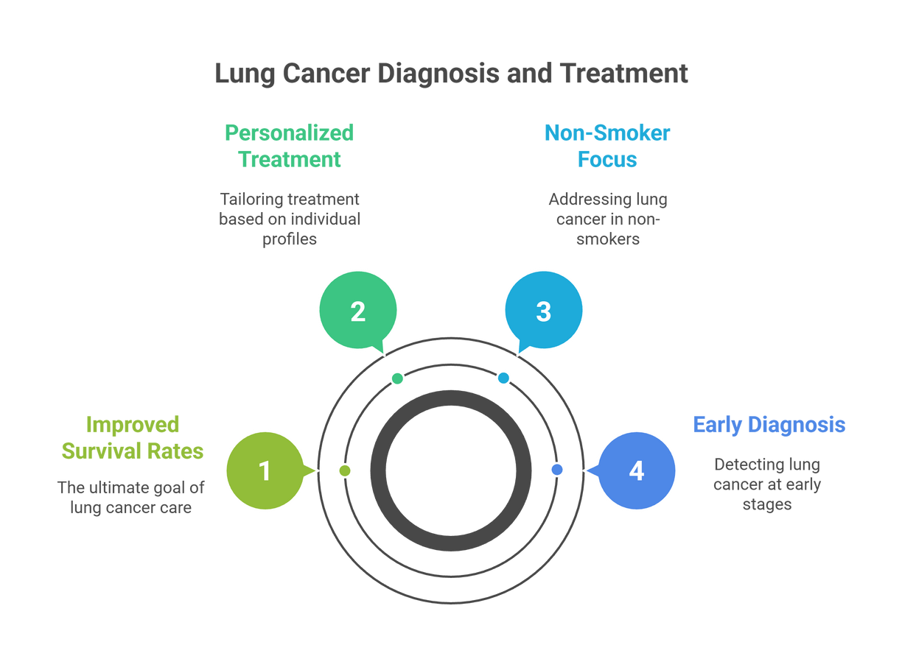
Introduction
Lung cancer is a leading cause of cancer death.
Non-smokers account for a significant and rising proportion of cases (up to 40% in some populations).
Early diagnosis is crucial for improving outcomes.
Non-smoker lung cancers show clinical and molecular differences from smoker-related lung cancers.

Slide 3
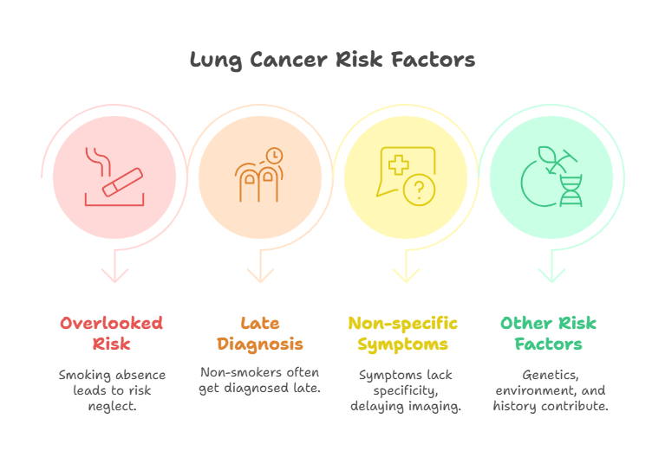
The Challenge in Non-Smokers
Traditional risk factor (smoking) is absent—risk often overlooked.
Many non-smoker cases diagnosed at late stages.
Symptoms are non-specific; imaging is not always performed early.
Risk factors: genetics, environmental exposures (radon, pollution), prior lung disease, family history.

Slide 4
Researchpaper number | Datasets used | Published year | Description | Metric used
[1] | Epidemiological datasets (Taiwan, England, S. Korea), molecular and mechanistic studies | 2024 | Explores how PM2.5 exposure induces lung cancer in nonsmokers, highlighting oxidative stress, genetic alterations, and clinical implications. Emphasizes prevention, early detection, and targeted therapies to mitigate air pollution effects. | Incidence rates, P-values, biomarkers
[2] | Regional epidemiological data from Asia, clinical registries, air pollution data | 2024 | Discusses lung cancer burden in Asia focusing on non-smoking-related lung cancer, PM2.5 exposure, healthcare gaps, and the need for region-specific interventions. Reviews regional studies on climate, screening, and therapies. | Incidence rates, screening coverage, healthcare access
[3] | GDS3837 gene expression dataset | 2024 | Uses machine learning (XGBoost) on gene expression data to identify prognostic biomarkers in female nonsmokers with stage III NSCLC. Achieved AUC of 0.835 for prediction. | AUC = 0.835
[4] | Clinical trial data, genomic and clinical NSCLC datasets | 2024 | Comprehensive review of NSCLC diagnosis and management advances, stressing low-dose CT screening, immunotherapy, and precision medicine to improve outcomes in early and metastatic stages. | Survival outcomes, trial efficacy metrics

Slide 5
Researchpaper number | Datasets used | Published year | Description | Metrics Used
[5] | 224 women case-control study dataset from North Sumatera, Indonesia | 2024 | Identifies risk factors for lung cancer in nonsmoking women, including passive smoking, genetics, and air pollution; underscores need for early screening and public health interventions. | Odds ratios for risk factors (not specified)
[6] | Transcriptomic and clinical data from 17 cohorts, 2,852 NSCLC tumor samples | 2024 | Identifies survival-associated gene markers and druggable targets for NSCLC in smokers and nonsmokers using transcriptome analysis. Supports precision medicine development. | Survival analysis metrics (e.g., hazard ratios, not detailed)
[7] | LDCT screening data from Korea and Japan never-smoker populations | 2025 | Reviews lung cancer screening efficacy in never-smokers showing detection rates ~0.45%-0.48%, mostly early-stage adenocarcinomas; supports selective LDCT screening implementation. | Detection rate, stage distribution
[8] | Retrospective cohort of over 28,000 LDCT screenings in Korea (12,176 never-smokers) | 2018 | Demonstrates LDCT's clinical value for early lung cancer detection in never-smokers with 0.45% cancer detection, mostly stage I adenocarcinomas, highlighting screening feasibility. | Detection rate, stage distribution

Slide 6
Reasearch papers number | Datasets Used | published year | Description | Metrics used
[9] | Global epidemiology, literature review, LDCT cohort data | 2021 | Expert report reviewing challenges and gaps in lung cancer screening for never-smokers globally, emphasizing risk factors and the need for refined risk models and country-specific policies. | Prevalence, risk model discrimination
[10] | Multi-omics data integration from LCNS patients | 2023 | Reviews the biology of lung cancer in never smokers, highlighting molecular subtypes, driver mutations, immune heterogeneity, and implications for precision screening and therapeutics. | Mutation frequency, immune profiling

Slide 7
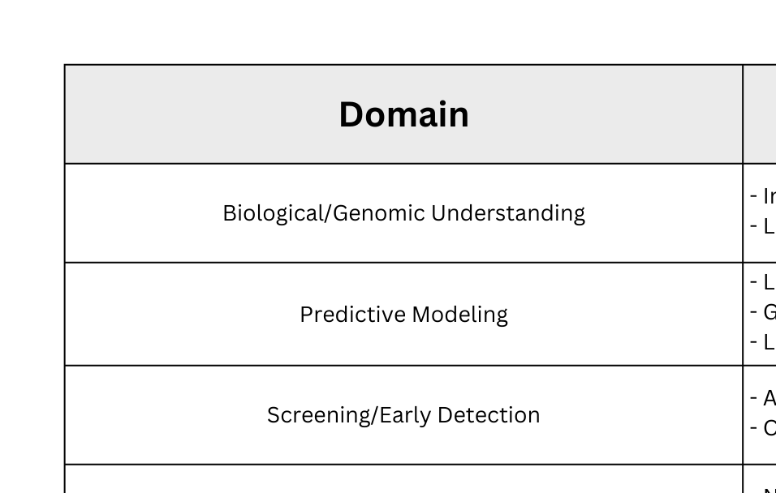
Research Gap

Slide 8
Project Aim and Objectives
Aim:
Explore genomic markers and predictive modelling for early lung cancer detection specifically in non-smokers using Agentic AI.
Objectives:
Review distinct genomics of lung cancer in non-smokers.
Analyze current predictive models and their limitations in this group.
Identify existing research gaps and propose future directions.

Slide 9
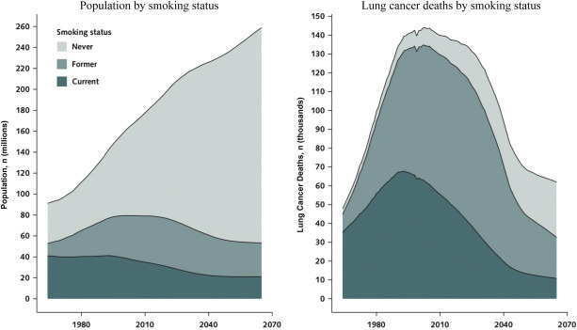
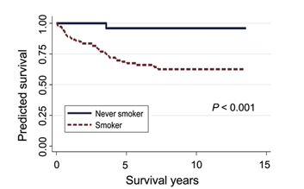
Non-Smokers and Lung Cancer — Epidemiology
15%-53% of lung cancer cases in women and 2%-15% in men are non-smokers globally.
Adenocarcinoma is the most common subtype in non-smokers.
Highest rates in non-smoking Asian women and postmenopausal women.
Non-smoker cancers often driven by unique genetic events, not tobacco mutagens.

Slide 10

Genomic Profiling — What and Why
Identifying mutations, gene expression changes, and structural variants.
Key genes in non-smokers: EGFR mutations (very frequent), ALK and ROS1 fusions, TERT, TP63, and others.
Unique mutational signatures and immune microenvironments distinct from smokers.
Foundation for personalized therapies and early risk stratification.

Slide 11

Predictive Modelling in Non-Smokers
Predictive models integrate clinical, demographic, environmental, and genomic factors.
Agentic AI models will be used to identify and perform risk scoring for each patient.
Models aim to identify high-risk never-smokers for targeted screening.
Existing generic models are less effective due to unique etiology.

Slide 12
Literature Survey
Models specifically for non-smokers are emerging.
Include variables: age, sex, family history, prior lung disease, genomic variants, exposures.
Studies show moderate success (AUC ~0.67–0.75) but need refinement.
Some efforts to integrate SNP data, autoantibodies, and environmental exposures for improved accuracy.
Most models exclude rare genomic variations found uniquely in non-smoker lung cancer.
No use of Agentic AI.

Slide 13
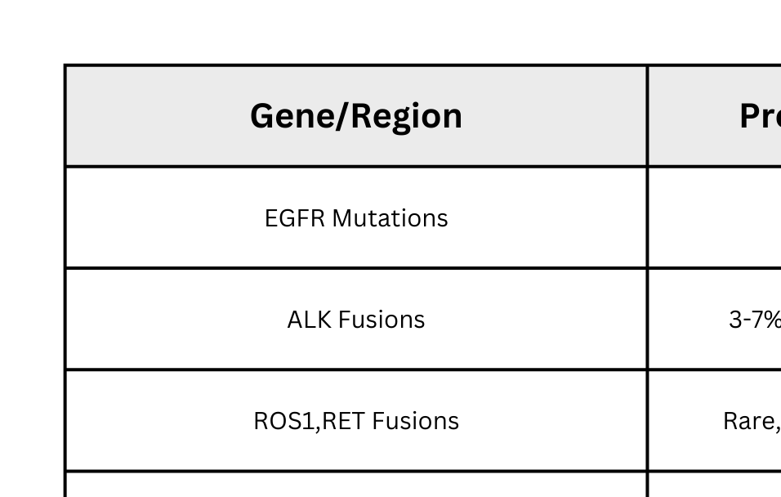
Genomic Markers Identified in Non-Smokers

Slide 14
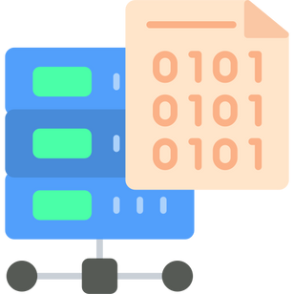
Available Data and Resources
Public genomic datasets:
TCGA (The Cancer Genome Atlas), GEO, UK Biobank.
Cohorts include hundreds of never-smoker lung cancer cases with paired clinical data.
Genomic data types:
DNA sequencing, RNA-Seq, copy number variation, SNP arrays, fusion detection.
Environmental and autoantibody data emerging in some cohorts.

Slide 15
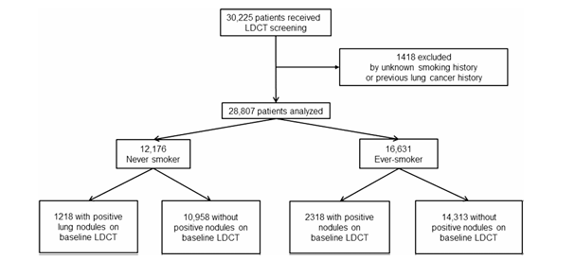
Challenges & Limitations
Technical: Tumor heterogeneity, low mutation burden in non-smokers, limited sample sizes, high-dimensional data.
Biological: Unique tumor biology, differential immunological profiles, rare variants.
Clinical: Cost and access to genomic testing, lack of affordable models for wide population screening.
Ethical: Data privacy, informed consent for risk-based stratification.

Slide 16

Future Directions
Build larger, ethnically diverse databases focusing on non-smokers.
Combine genomics with environmental and lifestyle data for more robust models.
Develop and externally validate agentic AI models tailored for never-smokers.
Incorporate liquid biopsy (cfDNA), proteomics, and autoantibody markers for minimally invasive screening.
Prospective clinical studies to establish screening effectiveness and guidelines.
Include explainability to increase confidene in the model.

Slide 17
Conclusion
Genomic profiling reveals actionable mutations for precise, early detection tailored to never-smokers.
Predictive models using genomic and clinical data increase accuracy and enable non-invasive screening.
Early detection lowers mortality, prevents unnecessary treatments, and improves outcomes.
Customized models address non-smoker-specific risk factors, outperforming generic tools.
Widespread use requires addressing cost, access, privacy, and ethical challenges.
Using Agentic AI helps us automate the process of identification and scoring.

Slide 18
Key References
[1] Chen, C.-Y., Kuo-Yen, & Yang, P.-C. (2024). The role of PM2.5 exposure in lung cancer: mechanisms, genetic factors, and clinical implications. EMBO Molecular Medicine. https://www.embopress.org/doi/full/10.1038/s44321-024-00175-2
[2] Chiu, C.-H., & Yang, P.-C. (2024). Challenges of lung cancer control in Asia. The Lancet eClinicalMedicine, 72, Article 102942. https://www.thelancet.com/journals/eclinm/article/PIIS2589-5370(24)00285-2/fulltext
[3] Zheng, H., Zhang, Q., Gong, Y., Liu, Z., & Chen, S. (2024). Identification of prognostic biomarkers for stage III non-small cell lung carcinoma in female nonsmokers using machine learning. In 2024 10th International Conference on Biomedical Engineering and Informatics (BMEI). https://ieeexplore.ieee.org/abstract/document/10762221
[4] Hendriks, L. E. L., Remon, J., Faivre-Finn, C., Garassino, M. C., Heymach, J. V., Kerr, K. M., Tan, D. S. W., Veronesi, G., & Reck, M. (2024). Non-small-cell lung cancer. Nature Reviews Disease Primers, 10, Article 43.

Slide 19
[5] Buana, I., Soeroso, N. N., Tarigan, S. P., & Syahruddin, E. (2022). Risk factors for lung cancer in non-smoking women, North Sumatera, Indonesia. Sumatera Medical Journal, 8(1), 28–34. https://doi.org/10.32734/sumej.v8i1.18763
[6] Győrffy, B. (2024). Transcriptome-level discovery of survival-associated biomarkers and therapy targets in non-small-cell lung cancer. British Journal of Pharmacology, 181(5), 1007–1022.
[7]Lam, S. (2025). Lung cancer screening in never-smokers. Current Opinion in Oncology, 37(1), 54–58. https://journals.lww.com/co-oncology/abstract/2025/01000/lung_cancer_screening_in_never_smokers.13.aspx
[8]Kang, H.-R., Cho, J. Y., Lee, S. H., Lee, Y. J., Park, J. S., Cho, Y.-J., Yoon, H. I., Lee, K. W., Lee, J. H., & Lee, C.-T. (2019). Role of low-dose computerized tomography in lung cancer screening among never-smokers. Journal of Thoracic Oncology, 14(10), 1649–1657.

Slide 20
[9] Kerpel-Fronius, A., Tammemägi, M., Cavic, M., Henschke, C., Jiang, L., Kazerooni, E., Lee, C.-T., Ventura, L., Yang, D., Lam, S., Huber, R. M., et al. (2022). Screening for lung cancer in individuals who never smoked: An International Association for the Study of Lung Cancer Early Detection and Screening Committee report. Journal of Thoracic Oncology, 17(2), 188–205. https://www.sciencedirect.com/science/article/pii/S1556086421023911
[10] Wang, P., Sun, S., Lam, S., & Lockwood, W. W. (2023). New insights into the biology and development of lung cancer in never smokers—Implications for early detection and treatment. Journal of Translational Medicine, 21(1), Article 484.

Slide 21
THANK YOU

